Slide 1
Pathology Workforce: Apprenticeships
Gopy Sundararajah
Regional Apprenticeship Lead, Pathology, South East

Slide 2
Apprenticeship
What is an apprenticeship?
Apprentices are employees who work, earn and learn.
They combine on-the-job training and experience, with off-the-job learning.
Apprentices can be new recruits or existing employees aged 16 years and above.
Most, but not all, Apprenticeships include a formal qualification and all learning is related to the skills, technical knowledge and practical experience required for the job.
They last for at least a year. The longest last for five years.
What do you need?
An apprentice must be employed in a job role for minimum 12 months
Apprentice must spend at least 20 per cent of their time on off-the-job training
Apprentices must be paid for time spent training or studying for the relevant qualification

Slide 3
Apprenticeship: Drivers
Levy over £3 million and 0.5% of taxable income from 2017
Apprenticeship frameworks are replaced by standards by 2020
Public sector employers of more than 250 people will have a target which they will need to report against annually.
Target for pathology workforce in South East to increase the numbers by 10

Slide 4
Benefits
Help develop clear career pathways and retain staff
Develop your existing workforce
Reshape your workforce
Apprenticeships have lower attrition rates
Attract and recruit from a wider pool of people in your local community
Flexibility and innovation to open the doors for future workforce
Recruit a diverse and representative workforce
Return on investment
BMS level 6 will include the portfolio work too

Slide 5
Apprenticeship Training - Things to Consider
Undertake a skills gap analysis and identify potential areas for apprenticeships (for both existing staff and new starters).
Develop career pathways for different services/departments
Scientific/clinical staff
Manager
Support staff
Identify staff development needs through appraisals and think about how these could be met through an apprenticeship.
Carry out a procurement exercise to engage training providers who can meet the organisation’s needs.
Consider including e-learning elements in your training.
Identify how you will support and monitor the progress of your apprentices.

Slide 6
Apprenticeship Education Level
Level | Equivalent Qualification | Apprenticeship
1 | Five GCSEs grade D-G or 1,2,3
2 | Five GCSEs grade A*-C or 9,8,7,6,5,4 NVQ level 2 | Intermediate
3 | Two A Levels NVQ level 3 | Advanced
4 | Certificate of Higher Education NVQ level 4 | Higher
5 | Diploma of Higher Education Foundation Degree | Higher
6 | Bachelor’s degree | Degree
7 | Master’s Degree | Degree

Slide 7
https://www.ahcs.ac.uk/wp-content/uploads/2017/07/MSC-Programme-Slide-v0.5-100717-1024x709.jpg

Slide 8
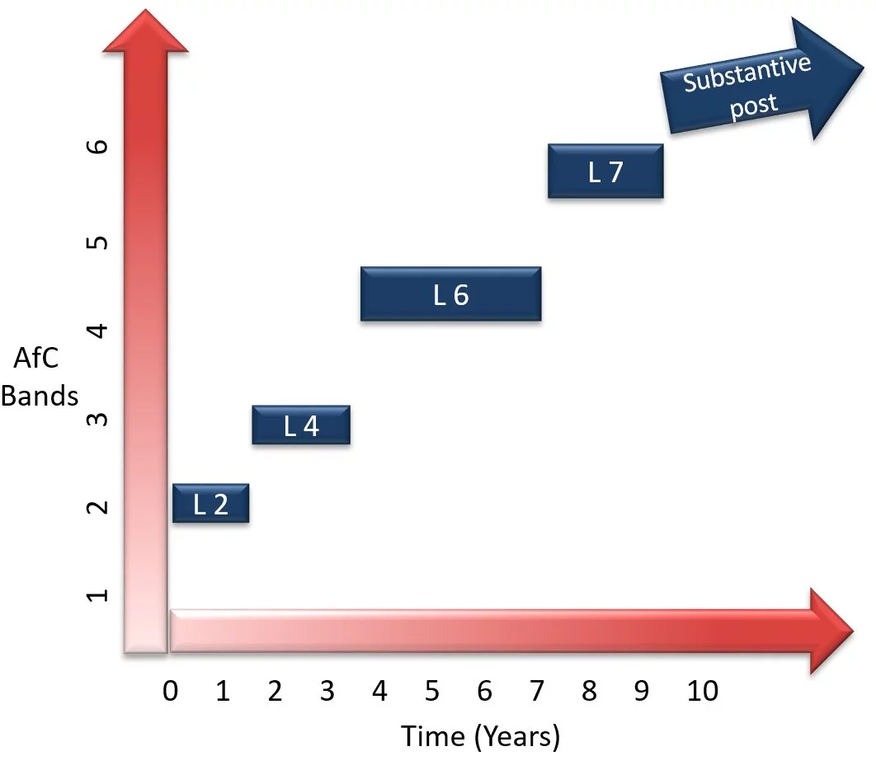
Healthcare Scientist Pathway
https://www.skillsforhcs.com/apprenticeships

Slide 9
What's Available in Pathology Workforce?
Scientific
L2 Healthcare Science Assistant
L3 Laboratory Technician
L4 Healthcare Science Associate
L6 Healthcare Science Practitioner Degree
L7 Clinical Scientist
L&D
L3 Learning Mentor
L5 Learning and Skills Teacher
Management
L3 Team Leader
L5 Operations Manager
L7 Senior Leadership
Business & Support
L2 Recruitment Resourcer
L2 & L3 Customer Service
L3 & L4 Business Administration
L2 Supply Chain Warehouse Operative
L4 Commercial Procurement and Supply
L3 Infrastructure Technician
L4 Data Analyst
L4 Business Analyst
L4 Quality Practitioner
L7 Accountancy Taxation Professional

Slide 10
Clinical Scientist – Level 7
Currently no providers for clinical scientist

Slide 11
Research Scientist Apprenticeship from Keele University
Names of programme(s): | MSc Technical Leadership (Analytical Science) MSc Technical Leadership (Biomedical Science) (Specialism: Analytical or Biomedical Science) (Delivering the Research Scientist Apprenticeship)
Mode of study: | Part-time (Apprenticeship)
Framework of Higher Education Qualification (FHEQ) level of final award: | Level 7
Duration: | Two years part-time
MAN-40160: Project & Processes (30 credits) / blended delivery
PHY-40029: Data Analysis (15 credits) / blended delivery
CHE-40044: Research Communication (15 credits) / blended delivery
R&D (30 credits): in Analytical Science (CHE-40042) or Biomedical Science (LSC-40069) / 2-week residential
MAN-40158: Leading Teams (30 credits) / blended delivery

Slide 12
Cost of Apprenticeship
Paid through apprenticeship levy and its generally underspend by Trust
Funding of £1,000 is available for employers to support 16-18-year olds into employment.
There is also additional funding support of £1,000 available for employers who employ apprentices aged 19-24, who have previously been in care or who have a local authority education, health and care plan and may need extra support
Other funding through HEE

Slide 13
20% Off the Bench
Off-the-job training must deliver new skills that are directly relevant to the apprenticeship. It can include the following:
the teaching of theory (for example, lectures, role playing, simulation exercises, online learning, and manufacturer training);
practical training, shadowing, mentoring, industry visits, and participation in competitions; or
Learning support and time spent writing assessments / assignments.
Off-the-job training does not include:
training to acquire knowledge, skills and behaviours that are not required in the apprenticeship standard;
progress reviews or on-programme assessment required for an apprenticeship standard; or
training which takes place outside the apprentice’s normal working hours.

Slide 15
Building Apprenticeships into the Workforce Strategy
Consider the following questions when developing your workforce plans.
How can a scaled-up apprenticeship offer act as an enabler of your workforce strategy?
How can apprenticeships enable you to meet key actions from the NHS People Plan, Workforce Race Equality Standard (WRES) and the Workforce Disability Equality Standard (WDES)?
How can apprenticeships enable you to be more representative of the community you serve?
Does your current apprenticeship offer align to the skills/talent pipeline you will need over the next five years?
How can the introduction/use of apprenticeships tackle your key workforce challenges?
Know the range of apprenticeships you could include as part of your workforce strategy.

Slide 16
Key Contacts
Training Lead/Manager
Pathology Laboratory Manager
Regional Healthcare Scientists Apprenticeship Lead
Trust Apprenticeship Lead /Advisor
Trust Healthcare Scientist Apprenticeship Lead
HEE – Regional Apprenticeship Relationship Manager

Slide 17
Questions?

